Slide 1
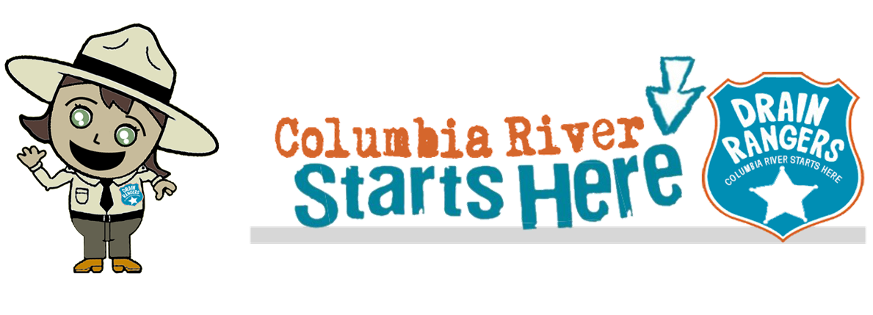






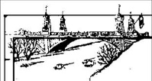

Stormwater – Explore and compare possible solution
Lesson 9
City of Asotin
City of Clarkston

Slide 2
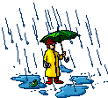
Lesson 9
  Define the Problem
  Research the Problem
  Understand the Stakeholders
  Explore and Compare Possible Solutions
  Develop a Plan
  Implement and Test the Plan
  Summarize, Evaluate and Reflect

Slide 3
Engineering Design - Stormwater
  So we’ve defined our problem as the quality and quantity of stormwater runoff in our community.

Slide 4
Pollution Prevention-changing personal actions such as using less fertilizer and cleaning up after your dog which can stop pollution at its source
Explore and Compare Possible Solutions

Slide 5
Lesson 9. Explore and Compare Possible Solutions
Pollution Prevention - Community Outreach Solutions
Informational outreach to influence behavior choices: brochures, videos, posters, website etc. to inform and convince people in the community to change behavior (The class could do more than one of these behaviors)
• Cars:
Fix that leak
Use car wash
• Natural Yard Care:
Limit fertilizers, herbicides, and pesticides
Plant trees and/or native plants
Improve Soils with compost
• Pets: Scoop the poop
• Pick up litter
Schoolyard Solutions (several items are in both columns):
• Planting trees and/or native plants
• Improving soils
• Rain gardens
• Disconnect downspouts
• Rain barrel or cistern
• Porous pavement

Slide 6
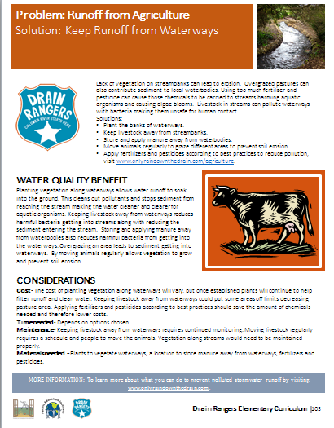
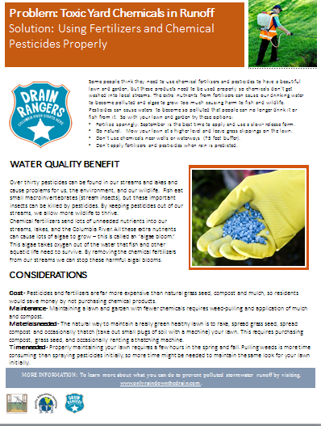
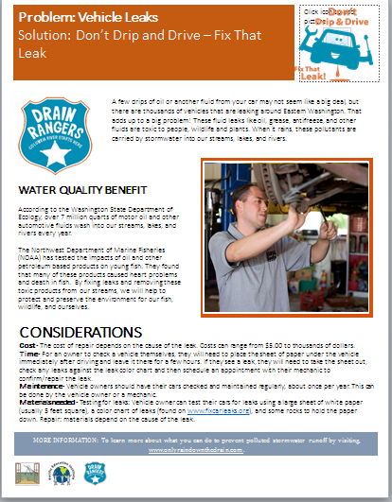
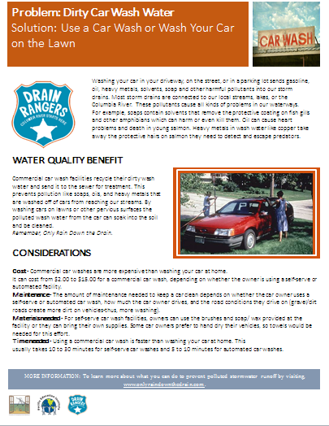
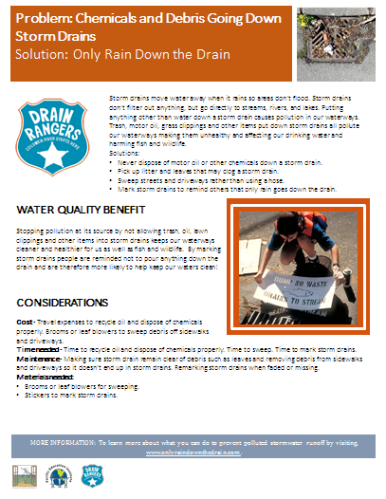
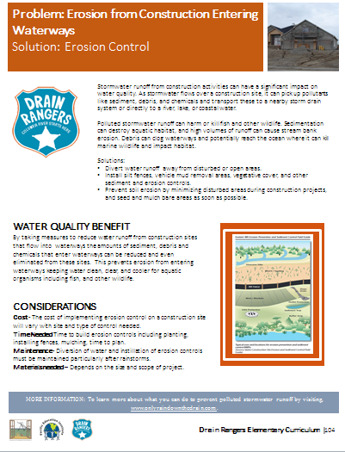
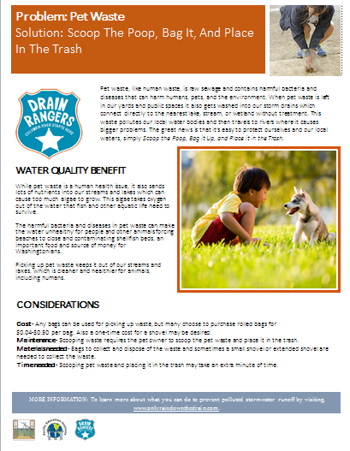
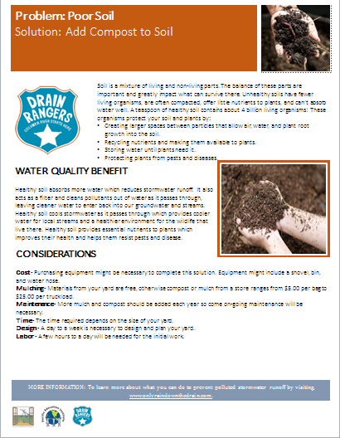
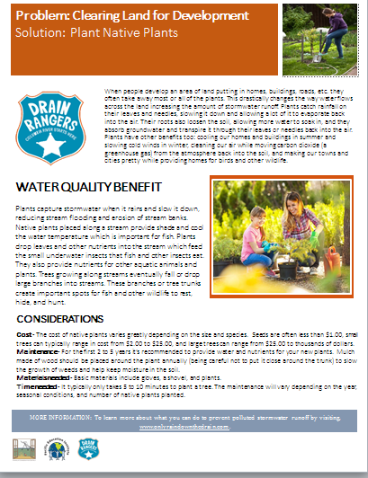
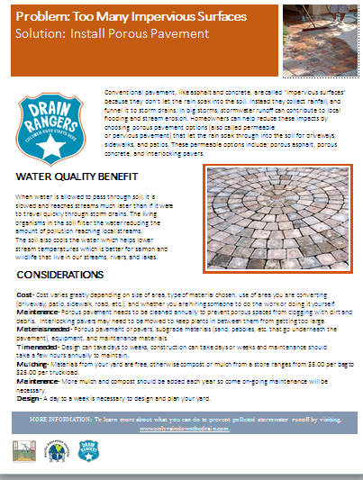
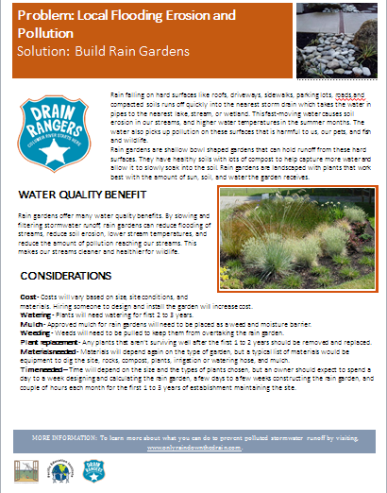
Lesson 9. Explore and Compare Possible Solutions
Look in the back of your Curriculum

Slide 7

Lesson 9. Explore and Compare Possible Solutions
Students do a jigsaw with the solution pages

Slide 8

Lesson 9. Explore and Compare Possible Solutions
What is the Problem?
What is a solution?
What are the benefits?
What are the considerations?
Find another person with a different solution

Slide 9
Lesson 9. Explore and Compare Possible Solutions

